Slide 1
Houston Fire Department Data report
12/6/2025
Presented by
Isaac Hocker

Slide 2
Topics that will be discussed
1
Emt & Fire Events by Station
2
EMS vs Fire events Comparison
3
Top 10 Busiest stations by EMS
4
Top 10 Stations by Fire Events
5
Top 10 slowest stations (EMS)
6
Top 10 slowest by Fire events
Company Name
Quarter Month
Year

Slide 3
Created by Isaac Hocker
For my project I wanted to used data from Houston Fire Department fom the year 2023 which would showcase incident reports based on EMS and Fire rescue calls. The reason I chose this project was because around this time last year I was previously enrolled in the Houston Fire Academy where I wanted to become a firefighter. The inspiration of becoming one was from my step father who became a firefight about 11 years ago. Due to some circumstances and challenges I faced I was not able to get passed the EMT portion of the school which was the hardest. Basically a 6 month program stuffed into 2 and a half months of school. Ever since then I’ve had an appreciation for first responders not just fire fighters, but also police officers as well. Even though I am not covering hpd hopefully my project gives you an insight about what all first responders go through.
Quarter Month
Year

Slide 4
The Difference between EMS & Fire rescue
EMS calls are usually higher volume than fire rescue call due to the severity of fire events that happen. Usually EMS calls can range from someone having trouble breathing, to a stroke and even a heart attack. They also respond to calls where there were car accidents and fata shootings. While Fire rescue usually go to calls where there are burning buildings , but also calls where there might be a gas leak and a smoke detector going off.
Company Name
Quarter Month
Year

Slide 5
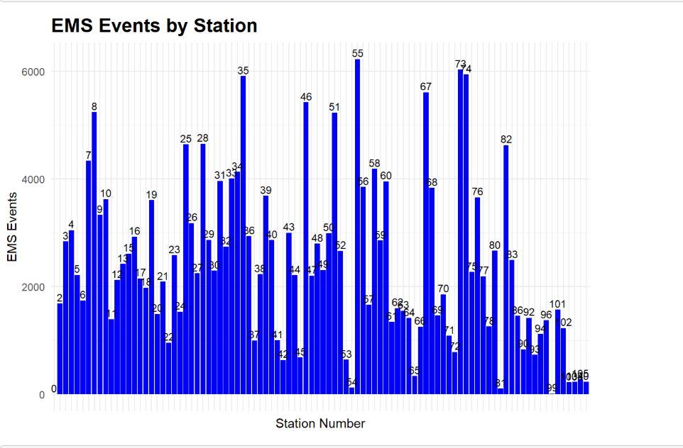
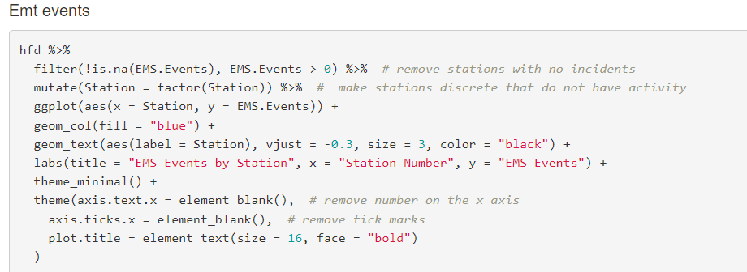
Date
Emt Events
This chart shows how many EMS events each station handled during the year of 2023. The taller bars represent the stations who had higher number of call volumes compared to the other stations with the lower numbers. The reason this data is important is because it highlights which areas based of the stations have highest emergency demand.

Slide 6
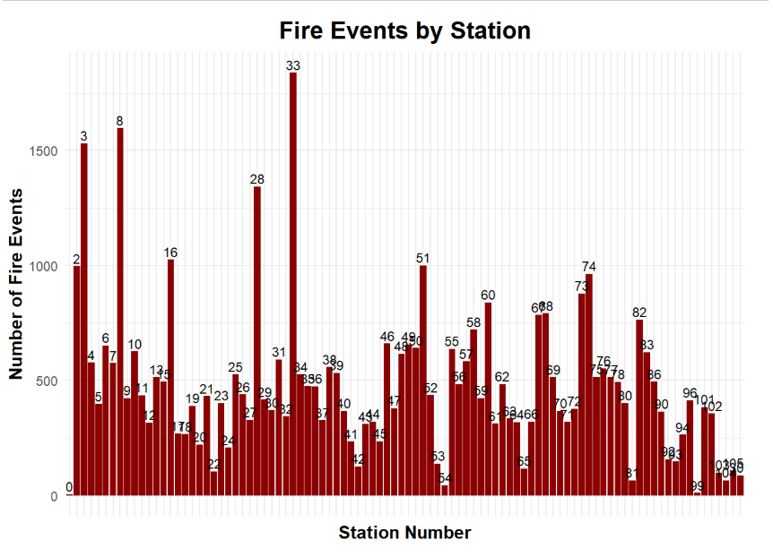
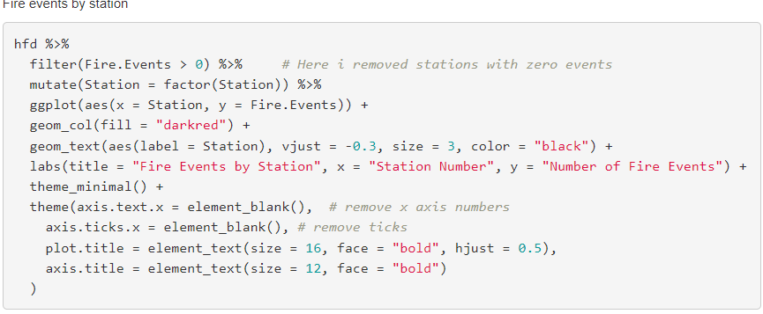
Fire Events
The graph helps identify which stations that deal with the highest amount of fire activity. Knowing which stations are busier can help as a being a civilian in the outside we can determine which areas have more emergencies which can cause heavy traffic. Most of the time fires can start from numerous factors such as population density, older buildings with old wiring , and neighborhoods with higher risk factors.

Slide 7
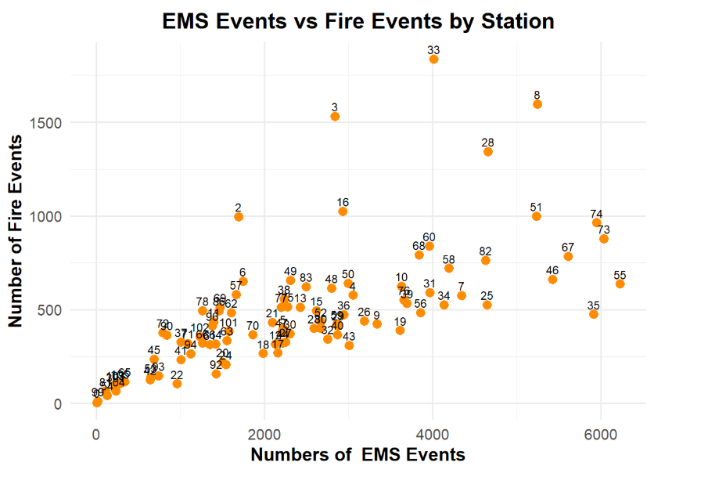
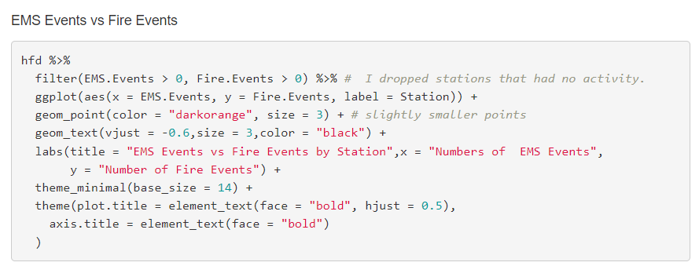
Ems Events vs Fire events
This graph shows how the relationship between two types of emergency activities. Seeing how these events move together helps identify stations that face heavier workloads and may require additional support such as staffing. In a real emergency operations, strong relationship between both EMS and fire can help not just each other but us as well. Such as resolving incidents faster and especially safer for everyone else.

Slide 8
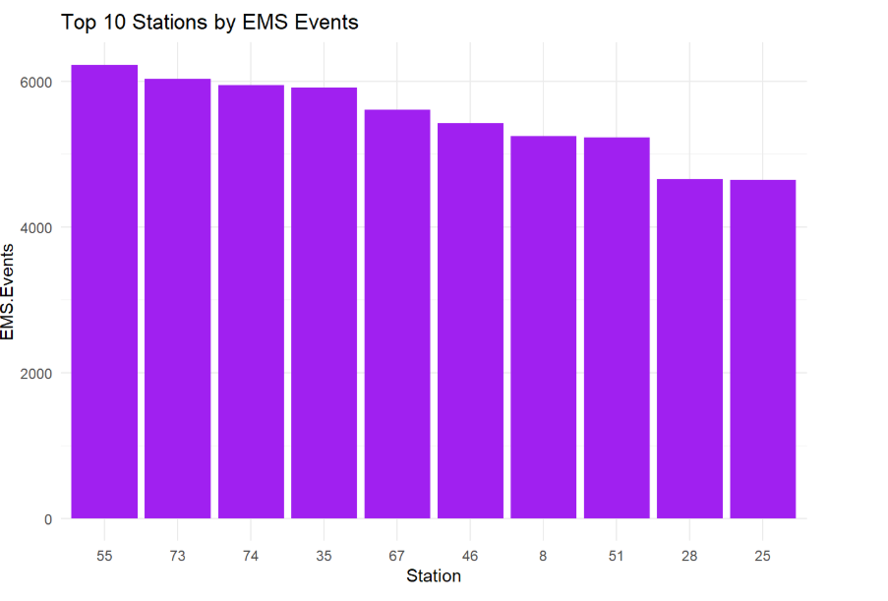
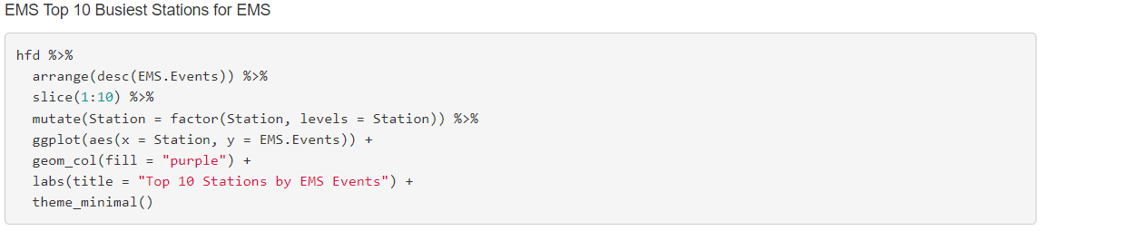
Top 10 busiest stations by EMS calls
The graph on the right shows 10 of the busiest stations by EMS call volumes. The reason this is so important is so we can see which areas are the busiest and also seeing based on your eyes where we can add additional staffing or equipment based on how busy the stations are.

Slide 9
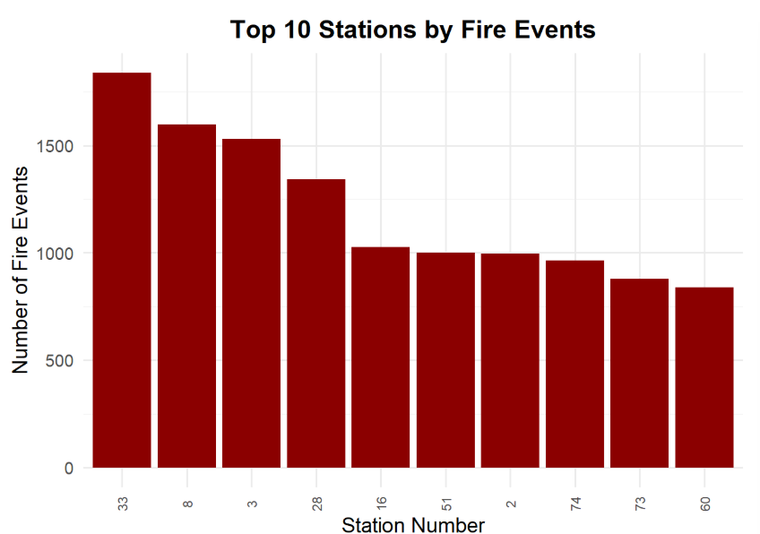
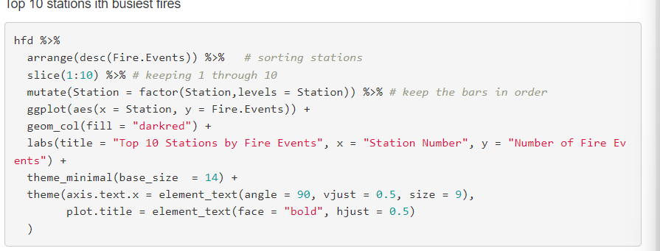
Busiest stations based on fire call volumes
In a real emergency operations, stations with heavy fire call volumes face more stress on personnel, equipment, and response times. Identifying these stations can help he department also better manage workloads and prepare for peak times when these calls do happen. High fire activity can indicate areas where prevention programs or building inspections could be placed to reduce risk.

Slide 10
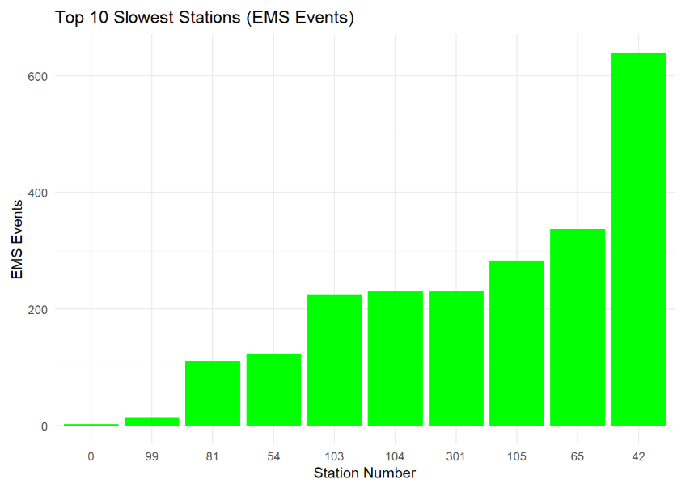
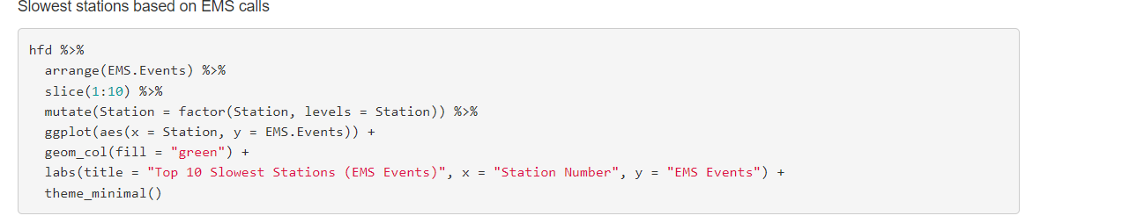
Slowest stations based on EMS calls
For this data I wanted to see where are the slowest stations based off EMS calls would be. The graph on the right helps determine if we need to put less resources in these stations and focus more on the busier stations. This could also benefit us as civilians to see which areas have lower risk of car accidents, and shootings that may happen as well. It’s safe to assume that where there are lower call volumes are generally safer areas.

Slide 11
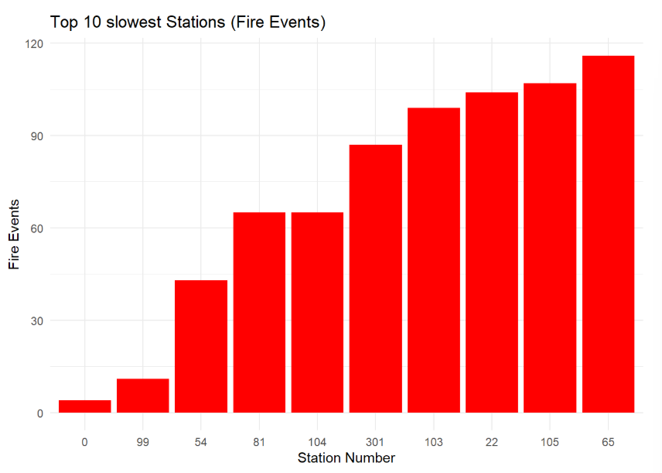
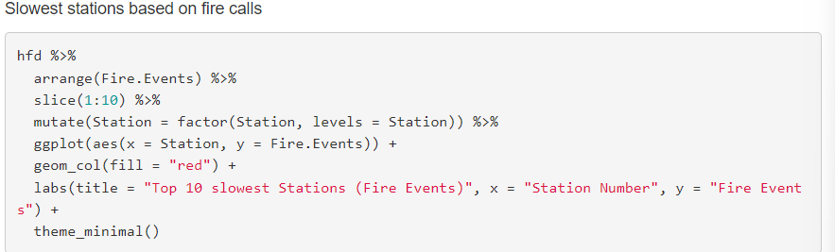
Slowest stations based on Fire rescue calls
AAs I did with EMS I wanted to do Fire calls as well to show if any of the stations share the same volume based on EMS calls and from the graphs of both we can see which ones don’t need as much staffing compared those with the highest call volumes.

Slide 12
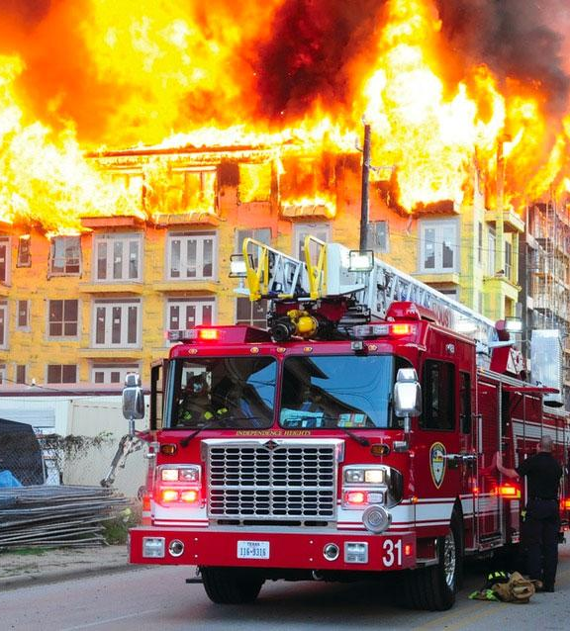
Limitations
The data set only reflects only time period and not long term trends, basically because it is based off 2023 year data doesn’t show the years after if there was and differences.
The data is aggregated(formed) by stations and events that happened. It does not include detailed call level events.
The data also does not specify what type of calls were specifically made but based on two categories which were Fire events and EMS events.

Slide 13
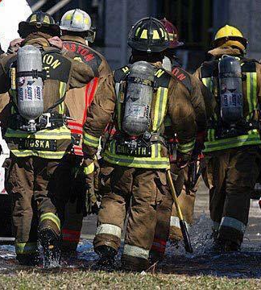
What we can learn from this data
This data gives an insight on how busy or how slow some stations are, which opens the eyes to those who might not be aware of how busy our first responders can be from a daily basis.
We can learn and benefit from this as well because the data shows each fire station and each fire station is located in a district that they monitor. How we can benefit from this is predetermining where heavy traffic or accidents occur and trying to avoid them. Also if you plan on moving to another are you can see which areas are typically safer compared to others.

Slide 14
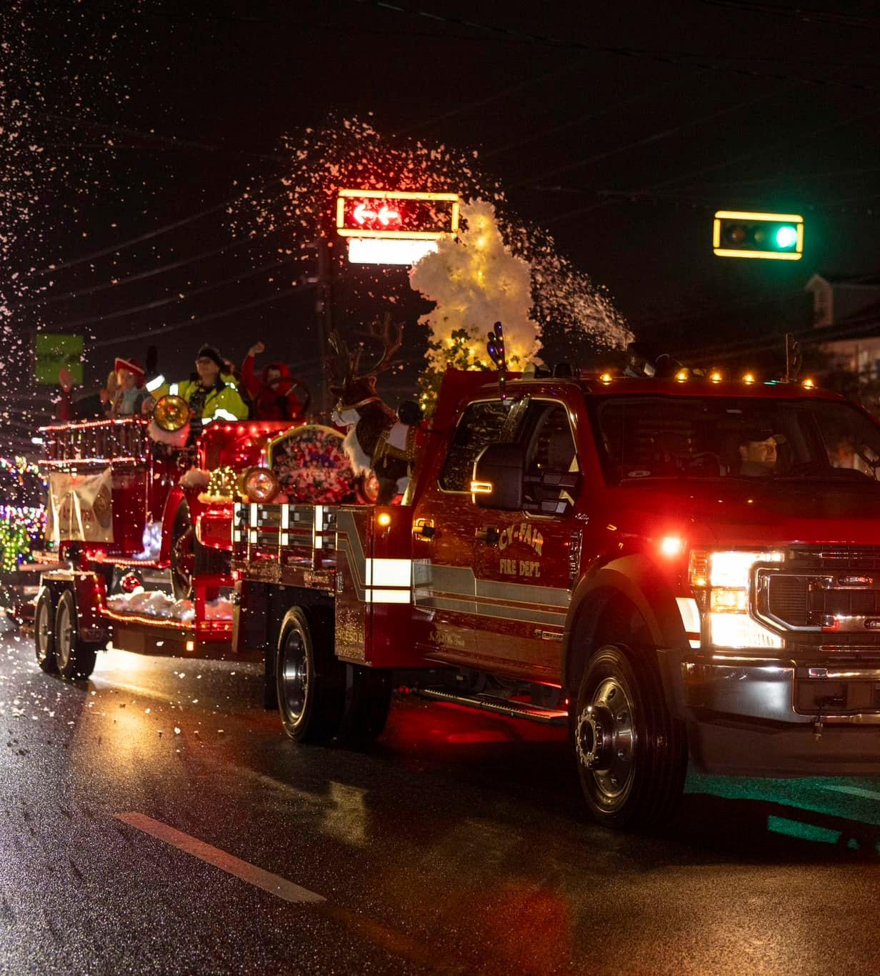
In conclusion
This analysis of Houston Fire Department incident data highlights a big difference in EMS and Fire emergencies across all stations. Several stations consistently reported higher call volumes, suggesting concentrated emergency demand in those areas. Understanding these pattern is useful in operational plannings, risk assessment, and where to put resources. While the data does not include detailed call types or precise geographical information, it still provides valuable insight into overall workload distribution.

